Slide 1

Prepared by Lee Shen Lei (2415662) and Lee Zhuo Min, Xavier (2401351)
DAVI AY2526S1
15 February, 2024

Slide 2


Team Members
Lee Zhuo Min, Xavier
Lee Shen Lei
Member
Member

Slide 3
Our Objective
Analyzed the cleaned Student Profiles and Semester Results datasets to understand student demographics, academic performance, and graduation outcomes.
Identify key drivers of performance (e.g., citizenship, qualification level, funding type, gender) and monitor trends over time.
Provide actionable insights to support academic planning, student support, and policy decisions

Slide 4
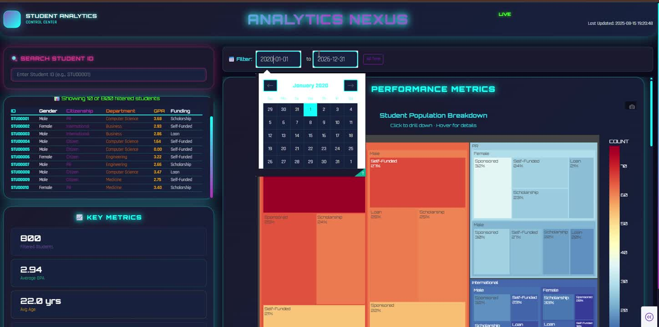
Dashboard Template
Our Layout:
The dashboard is designed with a header for branding and system status, a left column for search, student details, and KPIs, and a large scrollable right content area for performance metrics visualizations. This ensures both quick access to individual student insights and exploration of overall population trends.

Slide 5
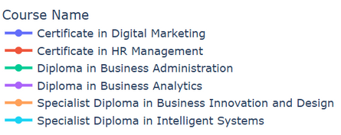
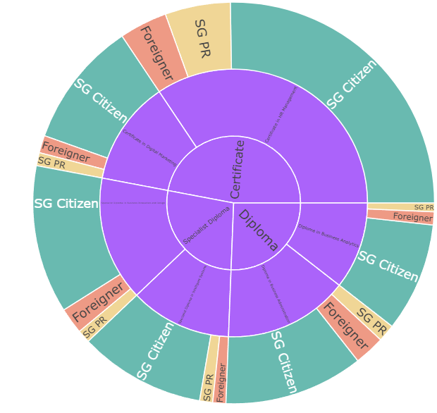
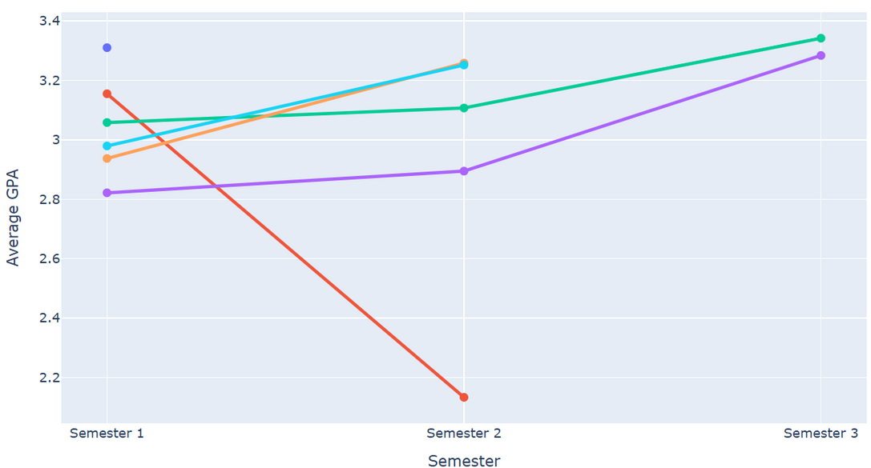
Xavier’s Charts
Singapore Citizens make up the majority of enrolments, especially in Certificate-level courses.
PRs and Foreigners favour Diploma and Specialist Diploma programs, often for career or migration benefits.
Specialist Diplomas attract a more diverse citizenship mix compared to Certificates
Most programs show rising GPAs over time, indicating academic improvement.
Specialist Diplomas maintain high GPAs (3.0+), reflecting selective entry.
Some courses, like HR Management, show GPA declines, suggesting increased difficulty.

Slide 6
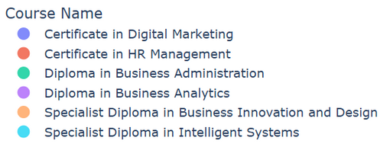
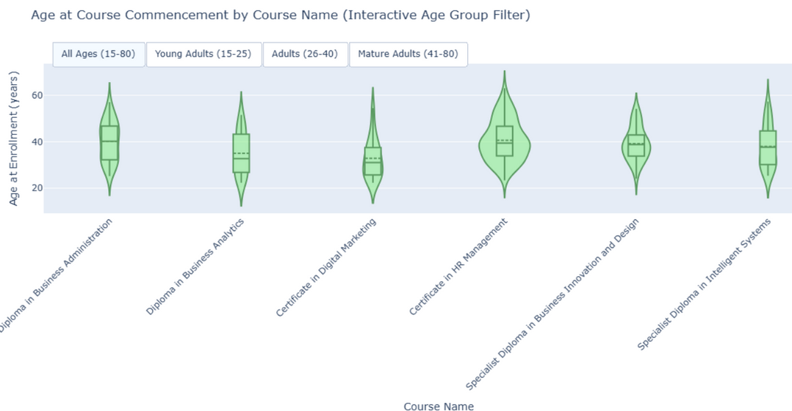
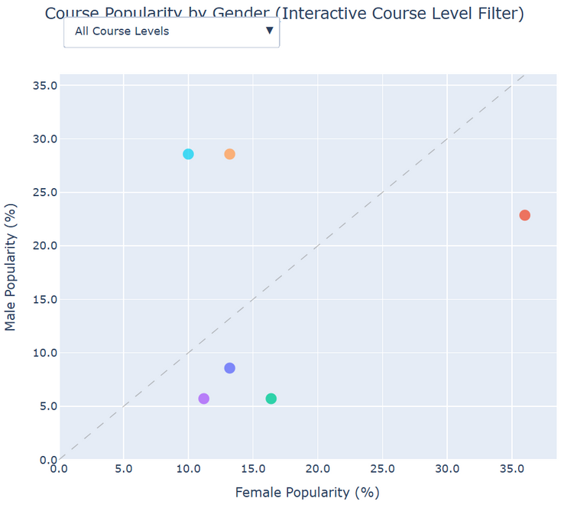
Xavier’s Charts
Wide age range (15–80) shows success of lifelong learning initiatives.
Most students are 20–35, reflecting early career and post-NS pathways.
Significant mid-career (30–45) participation indicates workforce transformation.
Gender clusters reveal persistent course selection preferences.
HR Management is female-dominated, while tech programs attract more males.
Diploma programs are more gender-balanced, appealing to a wider audience.

Slide 7
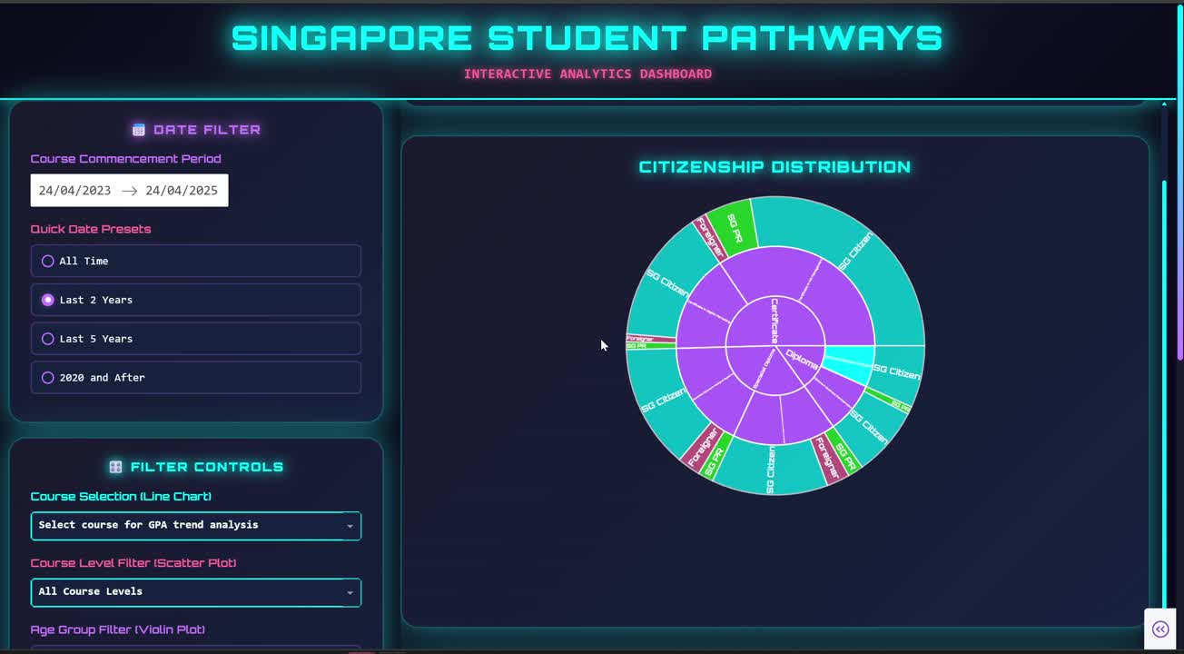
Xavier’s Dashboard

Slide 8
Xavier’s insight conclusion
Overall, the data shows that Singapore’s continuing education landscape is dominated by local citizens, with PRs and foreigners favouring higher-level qualifications like Diplomas and Specialist Diplomas. Academic performance generally improves over time, with Specialist Diplomas maintaining consistently high GPAs, although some programs face increasing difficulty.
Learners span a wide age range, from youths entering post-NS pathways to mid-career and mature workers seeking transformation or upskilling, reflecting strong support for lifelong learning. Gender patterns persist, with certain programs showing clear male or female dominance, while others achieve balance, highlighting opportunities for targeted outreach to diversify participation in emerging industries.

Slide 9
Xavier’s Recommendations
Make Certificate courses more appealing to PRs and Foreigners, while encouraging locals to take up Diplomas and Specialist Diplomas.
Work on balancing gender participation by getting more women into tech-related programs and more men into HR or people-focused courses.
Give extra learning support to courses where GPAs are dropping, like HR Management, to help students succeed.
Offer more flexible study options, such as part-time or modular learning, so mid-career and older learners can upskill without leaving their jobs.
Boost the global value of Specialist Diplomas by building stronger industry links and gaining international accreditation.

Slide 10
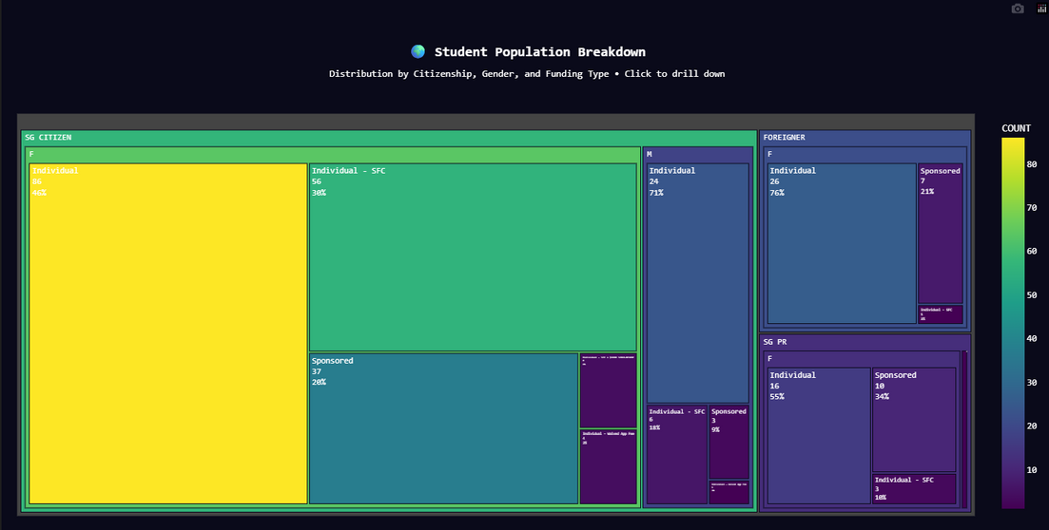
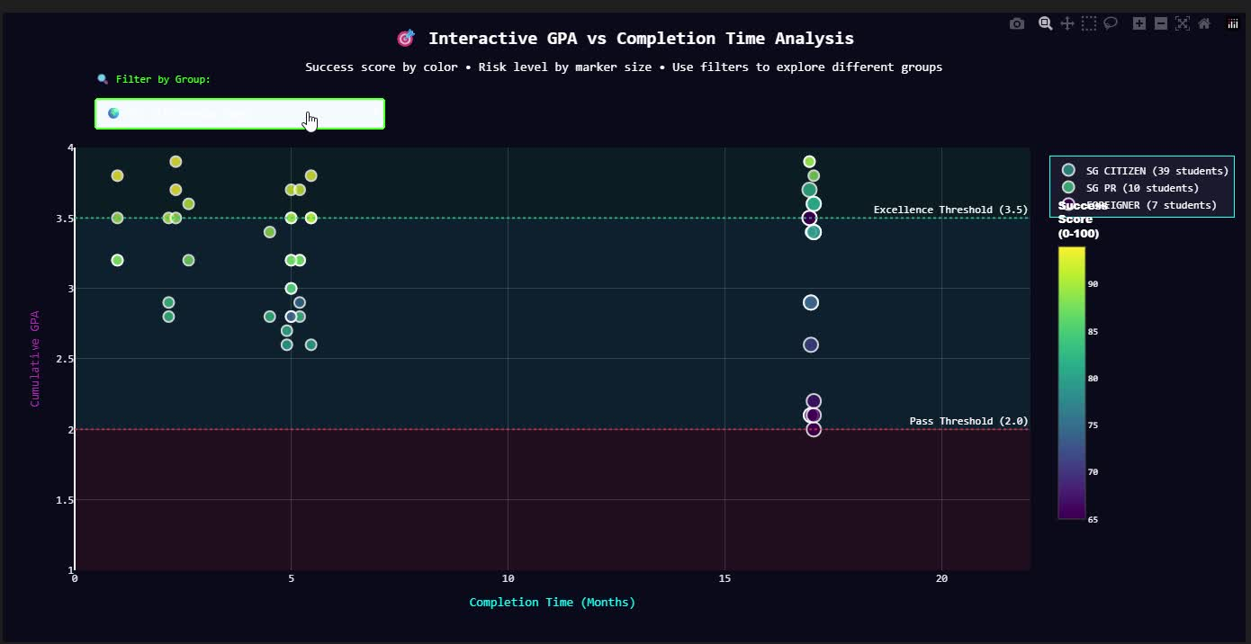
Shen Lei’s Charts
Key Insights
Singaporean students dominate overall, with females making up the majority; most are individually funded.
Scholarship sponsorship is concentrated among Singaporean females, showing targeted financial support.
Foreign students are primarily individually funded, indicating lower access to sponsorships.
Permanent Residents (PRs) show a balanced split between sponsored and individual funding.
Key Insights
Most students fall in the pass or high achiever range, with very few at-risk cases.
Citizen sponsored females make up the largest share of at-risk students, highlighting a need for early support.
PR students show average, stable performance — neither excelling nor struggling.
Foreign students perform relatively better overall, with stronger representation in the higher GPA ranges.

Slide 11
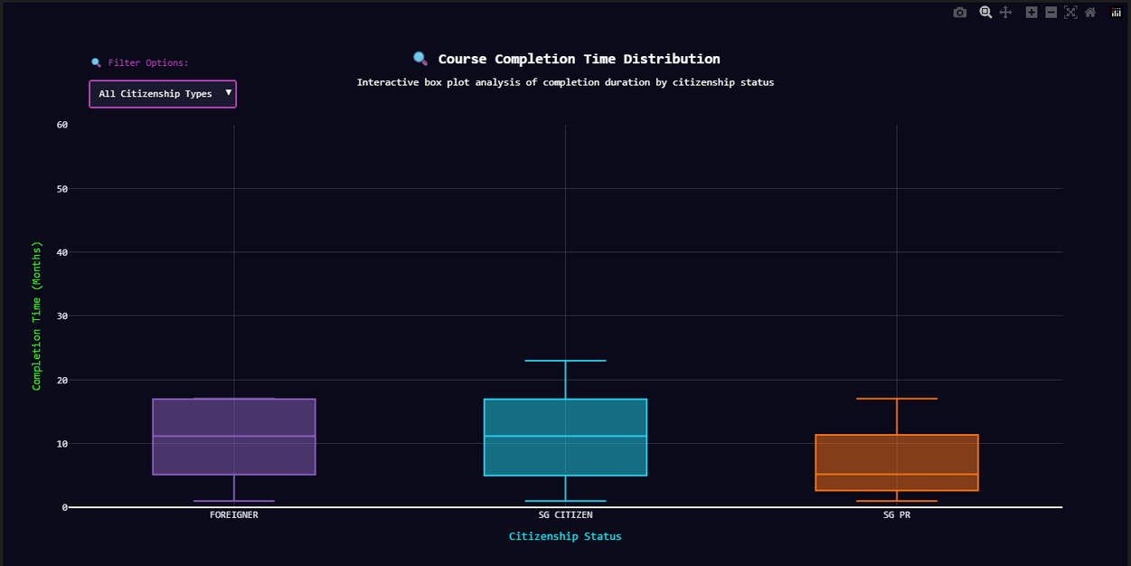
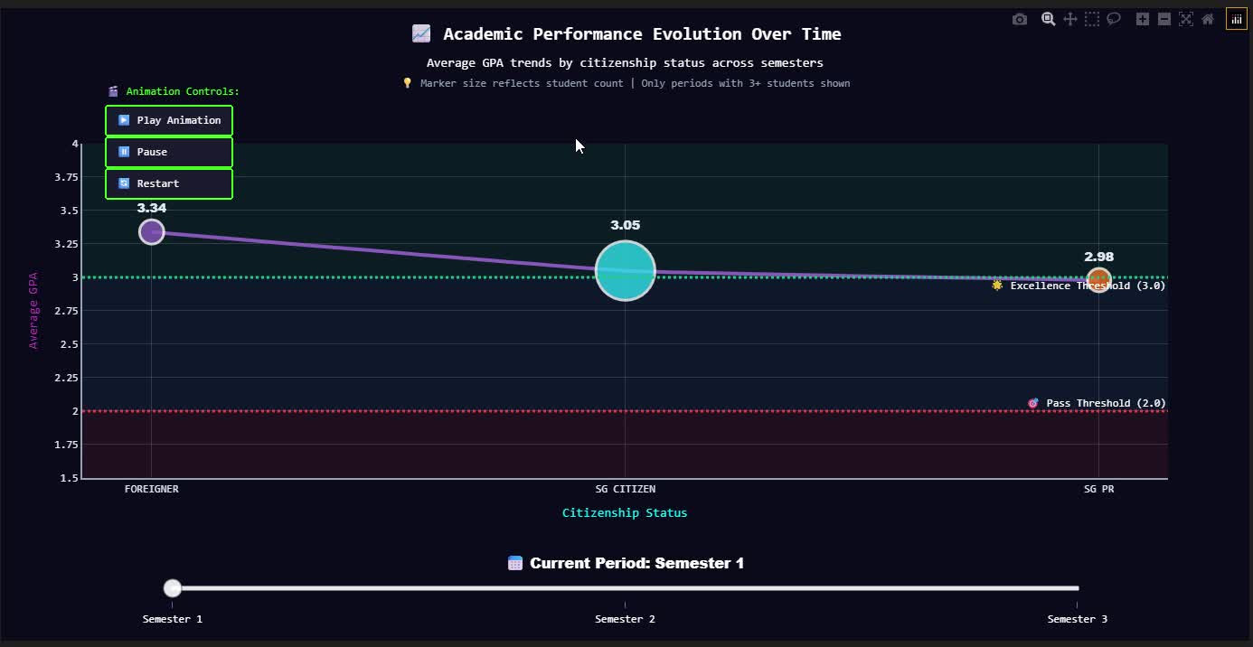
Shen Lei’s Charts
Key Insights
Singapore Citizens and Foreigners have a similar median completion time, indicating comparable overall progression pace. However, Citizens show a wider spread, with more students taking longer to finish, which could reflect higher cases of failures, repeats, or retention.
Foreigners display shorter and more consistent completion times, suggesting they are progressing more smoothly and performing relatively well.
Permanent Residents (PRs) have the lowest median completion time, likely due to enrolling in shorter certificate programs rather than full diplomas or degrees. This highlights how PRs may be prioritizing quick upskilling, while Citizens and Foreigners are more engaged in longer-term qualifications.
Key Insights
Foreigners consistently achieve the highest GPAs, followed by Singapore Citizens, with Permanent Residents (PRs) scoring lowest on average. This indicates that foreign students are performing strongest academically, while PRs may face challenges or be more concentrated in programs with stricter grading.
Semester 1 shows the largest student intake, but subsequent semesters have fewer students, suggesting that many enroll only for short-term certificate programs.
Semester 3 reflects a noticeable GPA boost across all groups, which could imply that either assessments in that semester are less demanding, or that only stronger-performing students persist until later semesters, thereby raising the average.

Slide 12
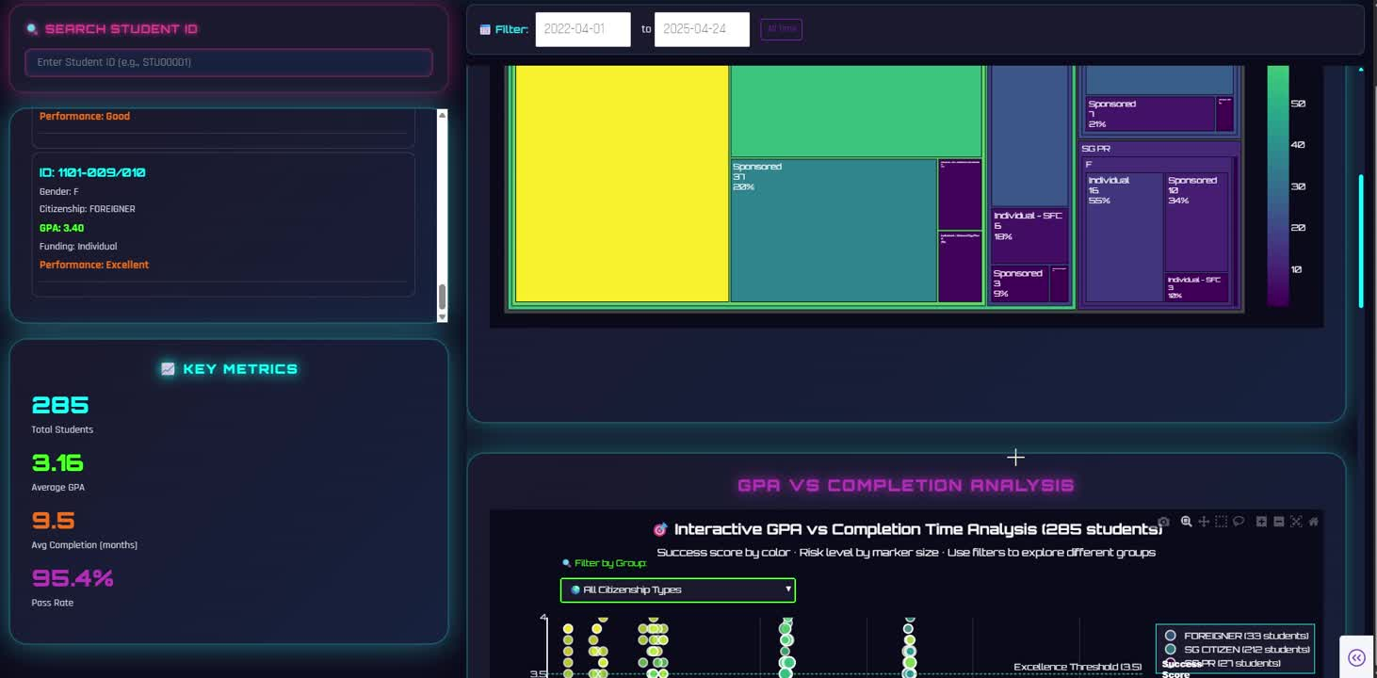
Shen Lei’s Dashboard

Slide 13
Conclusion of Insights(shen lei)
We see strong overall performance, but at-risk students, uneven scholarship access, variable completion times, GPA gaps, and early exits from programs highlight key areas for intervention. By strengthening support, diversifying aid, improving consistency, and encouraging progression, we can raise outcomes across all groups.

Slide 14
Recommendations(shen lei)
Support At-Risk Students
Focus early interventions on citizen-sponsored females, who make up most of the at-risk group.
Diversify Sponsorship
Extend scholarships to high-performing PRs and foreigners to reduce financial barriers and motivate retention.
Tackle Completion Delays
Provide stronger academic and mentoring support for citizens in longer programs, while offering PRs clear pathways to progress beyond certificates.
Close GPA Gaps
Introduce skill-building support for PRs and review grading consistency across semesters to balance outcomes.
Promote Long-Term Progression
Use stackable credits, bridging incentives, and progression scholarships to encourage certificate students to continue into diplomas or degrees.

Slide 15
Thamk you

